Slide 1
PHASE I: Library Resource Center project (LRC)
From July 2015 to June 2018
PHASE II: Library Learning Center project (LLC)
From July 2018 to June 2021
OVERALL GOAL OF THE
Reduce the vulnerability of workers while improving their capacities to contribute
18 Library Learning Centers set up in garment factories in 5
provinces (Kandal, Kampong Speu, Phnom
Penh, Siem Reap, Kampong Chhnang) with 20,000workers plan meet with CWPD and PHEs in factories.
* Since 2018, LLC replaces the term of Library Resource Center
OBJECTIVES
of self-learning and access to targeted documents, information and trainings
on soft-skills for workers
❑ Fight against illiteracy
❑ Contribute to the well being and the
socio-economic development of the workers and their families

Slide 2
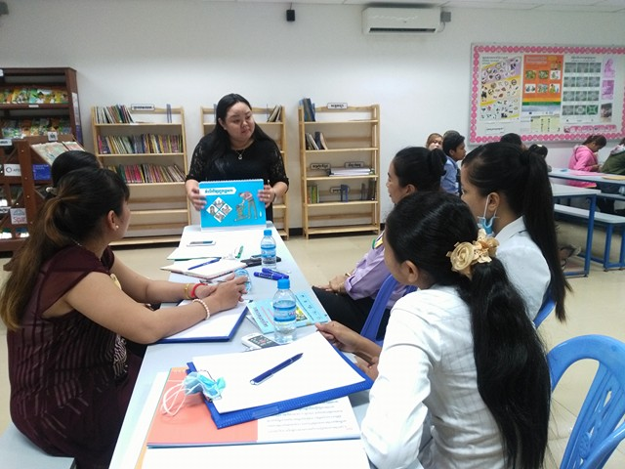
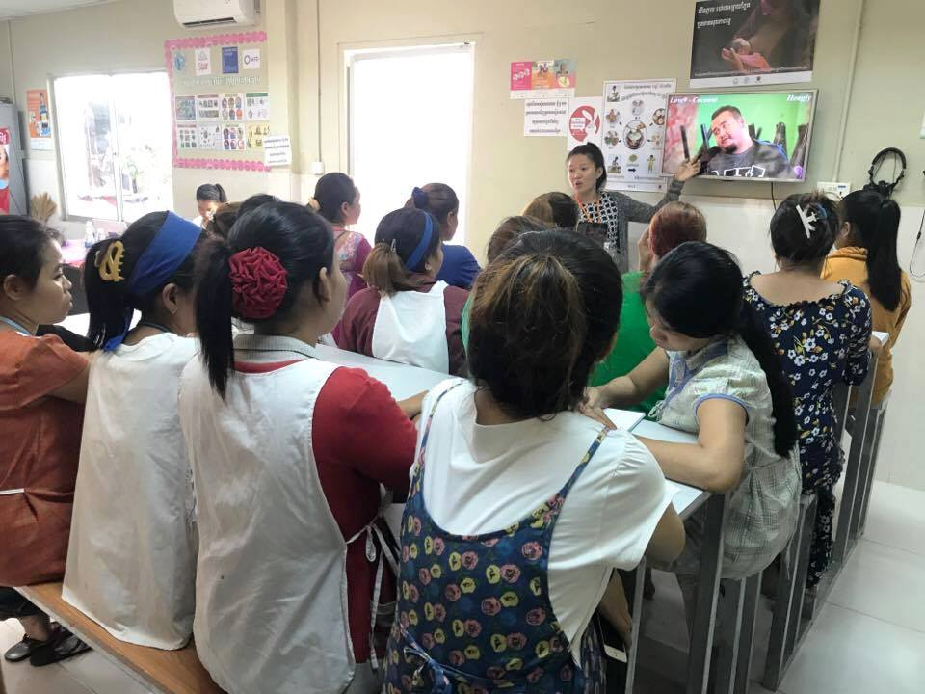
2- Awareness sessions on Social Issues
Trainers organize education and awareness sessions on
social issues the workers may encounter:
Nutrition, hygiene, reproductive and sexual health, mother & child health, HIV/AIDS, drugs, family planning, Occupational Safety and Health (OSH), domestic violence, financial literacy and road safety
How?
The NGO CWPD trained staff and workers to become peer- educators
Training Peer Peer-educators disseminate the messages
Workers are able to:
Find answers to their day-to-day questions
Improve their living conditions
Tools:
▪ 8 flip charts related to social issues produced within the framework of the project (HIV/Drug, hygiene, OSH, Domestic violence, financial literacy, road and safety, good parents, and lifelong learning)
▪ Life skill manuals on social issues
▪ Awareness video spots
Interactive awareness sessions for workers

Slide 3
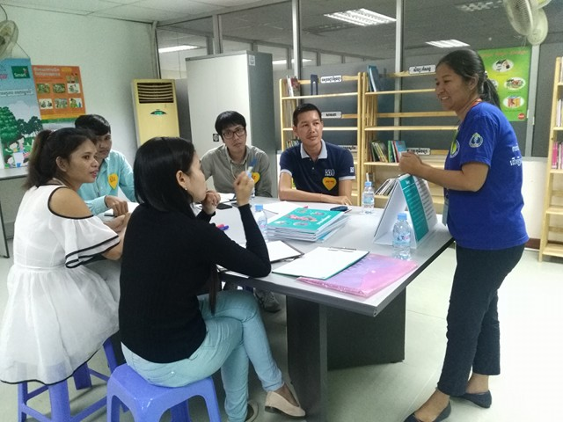
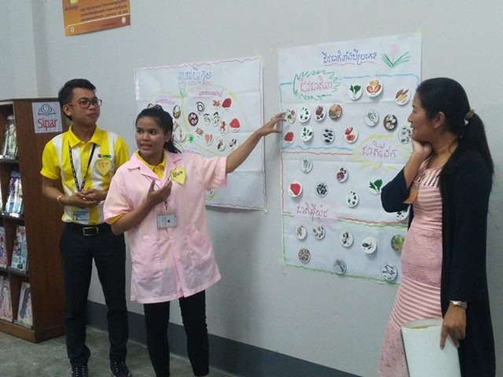
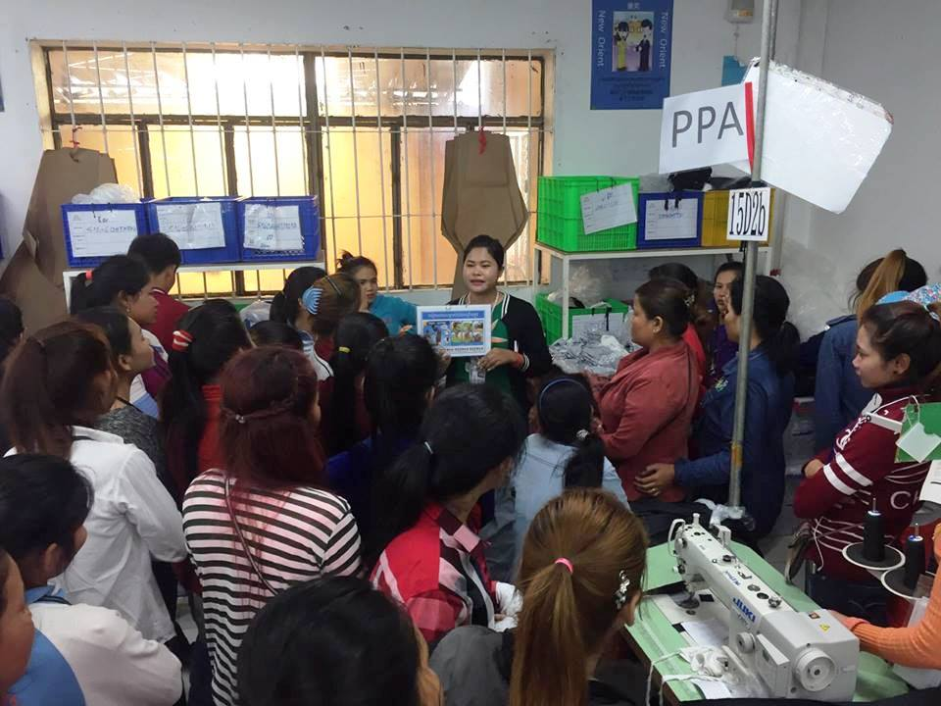
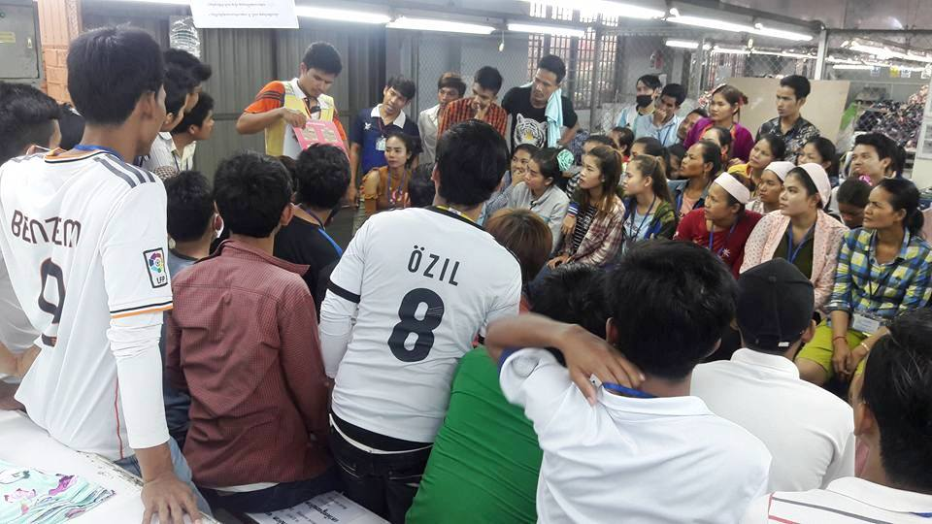
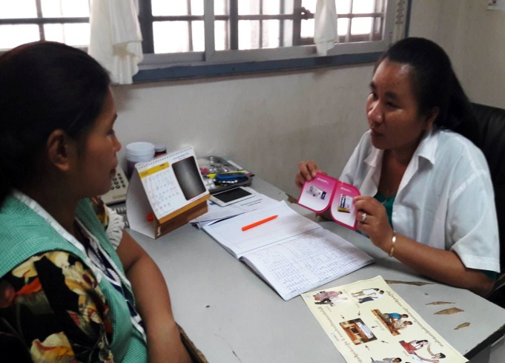
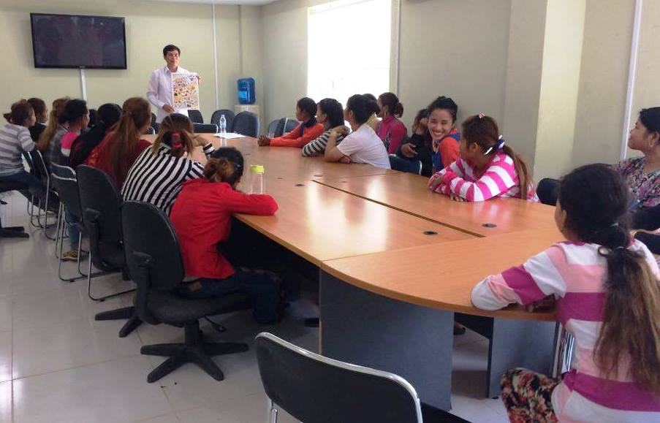
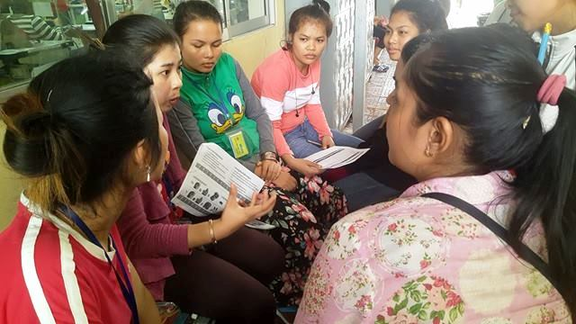
Results
PHEs Training.
87 trainings provided to PHEs,
892 attended (New: 487, old: 377).
2.Peers result.
19564 got education from peers.

Slide 4
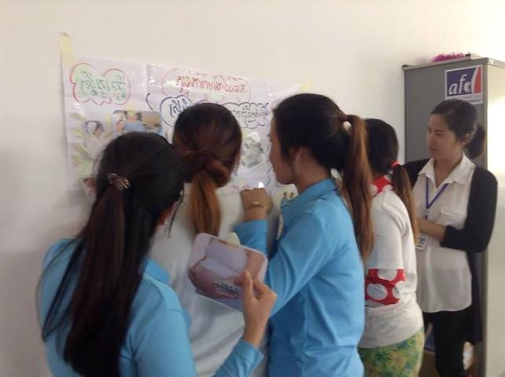
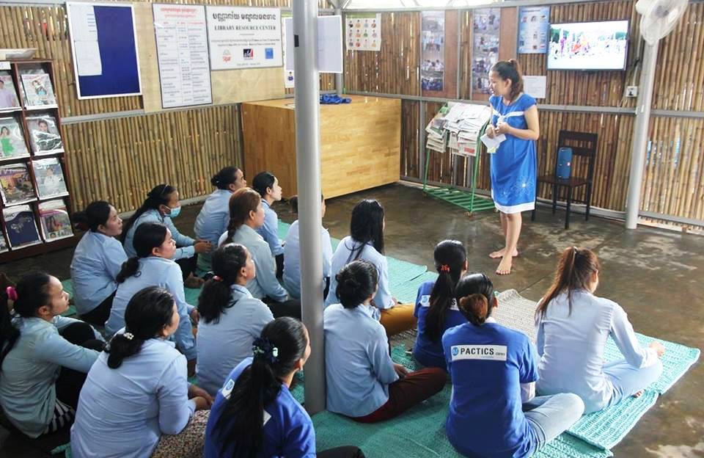
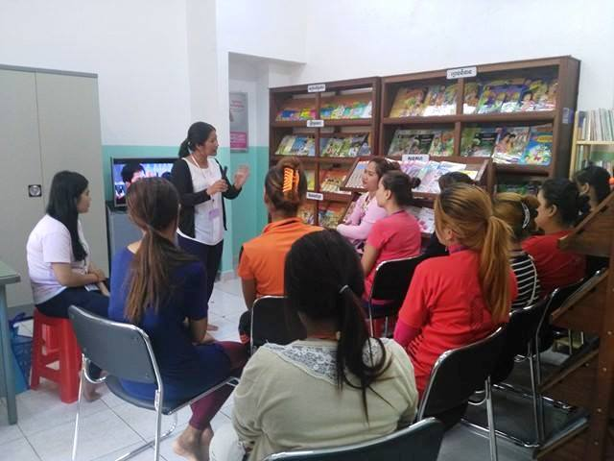
Results
2. Awareness session.
623 sessions provided to workers, 11996 workers Attended (Female: 10622 Male: 1374)
A large spectrum of awareness topics

Slide 5
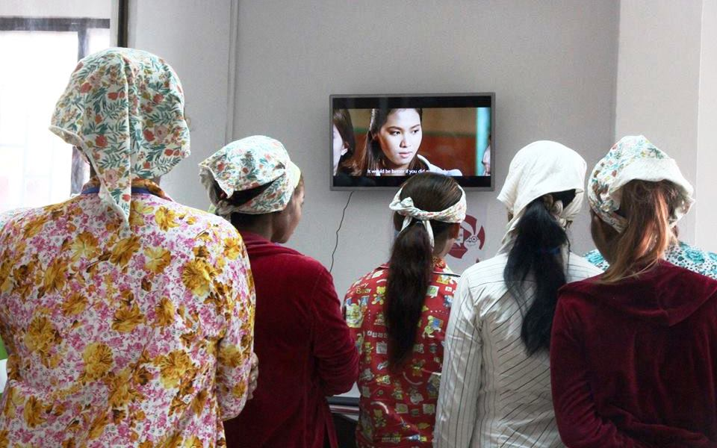
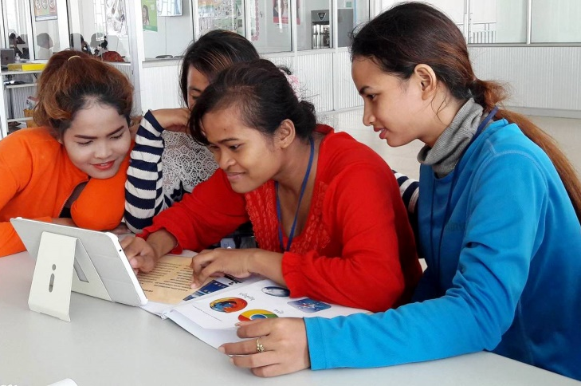
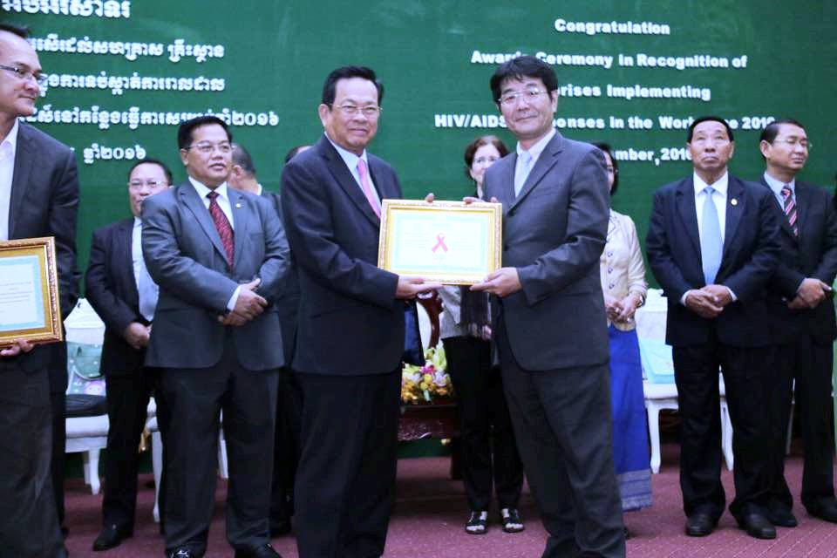
Results
Workers using TV and Tablet.
16921 workers
(female: 7366, Male: 9555)
Target factory got award from MoLVT.
Help factories running HIV/Drug policy to get award every year.

Slide 6
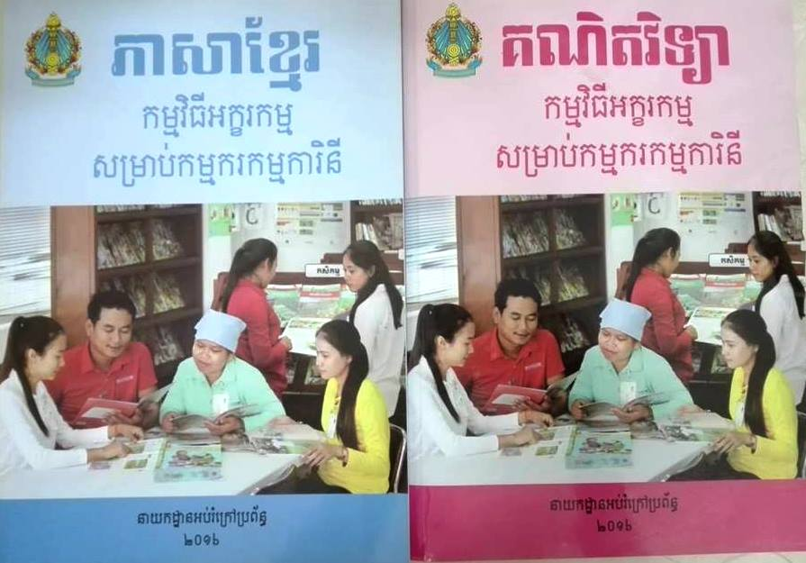
Results
Development 2 manual of basic literacy & numeracy and one guide book for teacher crated by a mixed team (MoEYS, UNESCO, Sipar, CWPD, MoWA).
3 Videos of project
One video spot produced to promote project
https://www.youtube.com/watch?v=6D0lr4k6iCc
One video spot produced to prevent the consummation of alcohol https://youtu.be/vvfXszlhK7U
One video spot on literacy class in factories https://youtu.be/MojMt4xamuw

